Slide 1
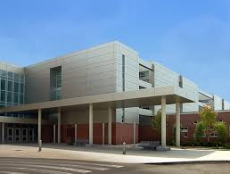
Renaissance High School New Student Orientation
How Will You Rise to the Occasion?

Slide 2
Renaissance High School Counseling Department
Last Names Counselor
A-F Mrs. Jones
G-L Mrs. Womble
M-R Mr. Duncan
S-Z Mr. Andrews
CTA Mr. Bracy

Slide 3
Common 8^{th –} 9th Grade Transitional Issues
Unfamiliar setting/environment
Increased building/population size
Increased potential distractions
Increased workload
Overwhelmed feeling
Confusion
Increased educational intensity
Increased focus-level required
Increased Autonomy
Cognitive
Academic
Affective
Social-Emotional
Expectations
Behavioral

Slide 4
PHOENIX SUMMER BRIDGE PROGRAM
“RENAISSANCE STATE OF MIND”
ACADEMIC
RIGOR
COURSES TAUGHT BY 9TH GRADE
TEACHERS
MATH PLACEMENT TESTING
SCHOOL CULTURE
RENAISSANCE METHOD OF OPERATIONS
DRESS CODE
ROTATING SCHEDULE
EARLY AWARNESS OF COLLEGE PROGRAMS
SOCIAL
BONDING TIME WITH INCOMING FRESHMEN
PANEL DISCUSSION WITH CURRENT RENAISSANCE STUDENTS

Slide 5
Academic Assistance Groups
Provides Strong Academic and Social Support
SIGNS
Entrance Exam score
Performance in Summer Bridge Program
Placement exams taken during Summer Bridge
SET UP
Small group sessions are held by counselors throughout the school year
Academic and Community partnerships are utilized
Students are assigned a NHS mentor
Student Accountability
Progress Reports
Tutoring Documentation
Meetings with mentor
Mandatory attendance at group sessions

Slide 6
TOPICS COVERED IN GROUP SESSIONS
Teach Skills and Habits Needed to Thrive in High School Academically
Social Emotional Concerns
Small Group Counseling Open to All 9th Graders
Getting the most out of classroom time
Study Skills/Time Management
How to prepare for Quizzes and Exams
Student Accountability
After School/Peer Tutoring
Parent Workshops
Create and Maintain Trusting Relationships
Students need to feel valued, included and connected to the school community
Peer Mentors
Senior/Freshmen Mixer
Freshmen Seminar/Senior Panel
Assemblies/ Workshops related to Social Issues
Cyber Bullying
Teen Violence
Drug/Alcohol Use
Community Partners
Male/Female Mentoring Groups

Slide 7
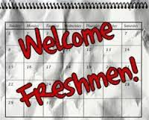
RENAISSANCE HIGH SCHOOL
ACADEMIC CURRICLUM
Overview

Slide 8
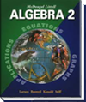
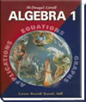
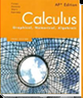
MATH 4 Year Course Offerings
9th Grade
10th Grade
11th Grade
12th Grade
Geometry
Algebra II
Algebra 1
Precalculus
Prob. & Stats.
AP® Statistics
Geometry H
Calculus
Algebra 1H
Algebra II H
Precalculus
AP® Calculus AB
Algebra II
Geometry
AP® Calculus AB
AP® Calculus BC
Accelerated Precalculus

Slide 9
Science Department Side-by-Side Comparison
Grade | College Prep | Engineering | Health
9 | NGS | NGS | NGS
10 | Biology | Biology or Honors Chemistry | Honors Chemistry
11 | Chemistry Chemistry and Forensics or AP Environmental | Chemistry AND Honors Physics or AP Chemistry | AP Chemistry AND Biology
12 | Forensics, AP Environmental Science, Physics or Anatomy and Physiology | AP Physics | AP Biology or Anatomy and Physiology

Slide 10
English Department Graduation Requirements
Grade | Courses
9 | English Language Arts 9
10 | English Language Arts 10 H
11 | English Language Arts 11 H or AP English Language Arts 11
12 | English Language Arts 12 H or AP English Language Arts 12

Slide 11
ENGLISH ELECTIVES
SPEECH AND DEBATE / PUBLIC SPEAKING
Speaking class focusing on the various types of public speaking and debate techniques
FILM STUDIES
For students interested in exploring and critiquing film as well as writing
original scripts and creating new versions of older scripts
ADVANCED STUDIES IN LITERATURE AND WRITING
Designed to enrich and enhance students’ exposure to literature and
expository writing skills.
JOURNALISM
Covers the fundamentals of news writing through reading to write skills and
strategies that identify and reveal news.
PUBLICATIONS (YEARBOOK)
Teaches students to design layouts, write, copy and produce publications. Meeting deadlines and organizational skills are a priority.

Slide 12
Social Studies Department Requirements
Grade | Courses
9 | U.S History
10 | Economics/Civics Semester Each
11 | World History and/or AP Economics, AP US History
12 | African American Studies, Psychology & Sociology, AP Econ, AP US History

Slide 13
We offer the following modern foreign language classes:
Foreign Language Department
French I, II, III, Honors French, and AP French
Spanish I, II, III, Honors Spanish, and AP Spanish
Arabic I and II

Slide 14
Business Department
Elective Courses
Business Management 1 (9th-11th graders only) No prerequisite required. This is a state-approved program.
Business Management 3 (10-11 graders only). Prerequisite is to have completed Business Management 1 with a grade of C or better.
Marketing 1 (10-12th graders only, no prerequisite course required.
Marketing 3 (11-12th graders only, prerequisite is Marketing 1)
Accounting 1 (10-11th graders only, prerequisite is Algebra 1) This is a two year state-approved program. All students must maintain a C average throughout course
CTSCO/Student Clubs: DECA/Phoenix Nest and BPA

Slide 15
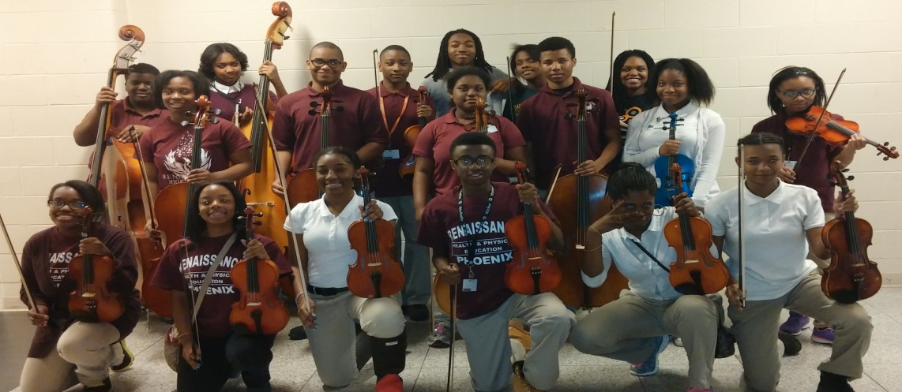
FINE ARTS DEPARTMENT
Dance 1 through Dance 8, Dance Workshop
C Bands (Beginning band, open to all), Symphonic Band, Concert Band, Jazz Band and Marching Band
Strings: Three Orchestras (Beginning, A Orchestra, B Orchestra)
Piano 1 (Beginning students)

Slide 16
Renaissance Vocal Music
Renaissance Varsity Chorus, Renaissance Singers, Renaissance Men,
A-Chord

Slide 17
Physical Education, Health & JROTC REQUIREMENT
PHYSICAL EDUCATION & HEALTH
1 Semester of Physical Education Required
1 Semester of Health Required
JROTC
1 year of JROTC-may replace the Physical Education or Health requirement.
2 years of JROTC – Replaces the Physical Education and Health Requirement.

